Slide 1
Advanced Analysis Topics
A Module in Agile Analysis
This work is licensed under the
Creative Commons Attribution-ShareAlike 4.0 International License.
To view a copy of this license, visit http://creativecommons.org/licenses/by-sa/4.0/.

Slide 2
User Experience and Agile Analysis

Slide 3
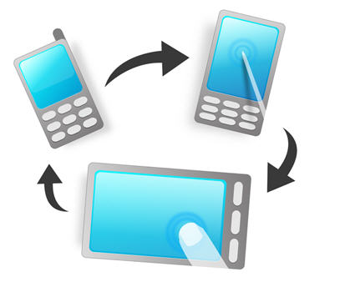
Role of User Experience
User Research
Interaction design
Usability
Knowledge transfer
Notes:
Areas of user experience participation.
Content – domain language
Structure – screen layout, patterns
Visual appearance – color, texture, typography, brand
Low: 1min
High: 3min

Slide 4
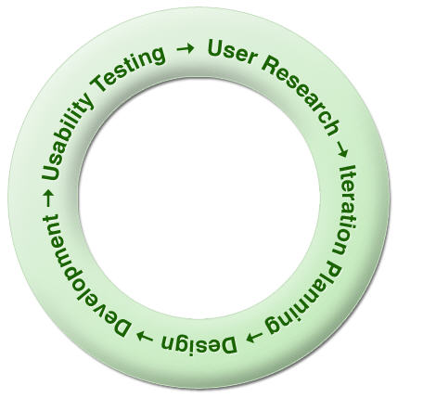
User Research
Contextual inquiry
Interviewing
Persona Modeling
Notes:
Contextual inquiry
Goal is to understand the customer’s needs, desires, approach to the work, who the customer really is
One-on-one interviews with customers in their workplace while they work - go where the work is and watch it happen
Data is interpreted in a team session to develop a shared view of all customers interviewed
Take pictures of the work environment to share with the team
Tape record the session
Interviewing
Remove all assumptions
Non directed questions – what, how, why, tell me more about
Persona Modeling
We’ve already covered these.
Could be mapped to categories, ex: account types
Bright UI in low lighting or the reverse. Color interpretation
Be pragmatic about the granularity of the research (Inception vs. development)
Domain complexity dictates how long you need to allow for user research
Feedback loop should be ongoing
Good resource: Contextual Design by Hugh Beyer, Karen Holtzblatt
Low: 3min
High: 5min

Slide 5
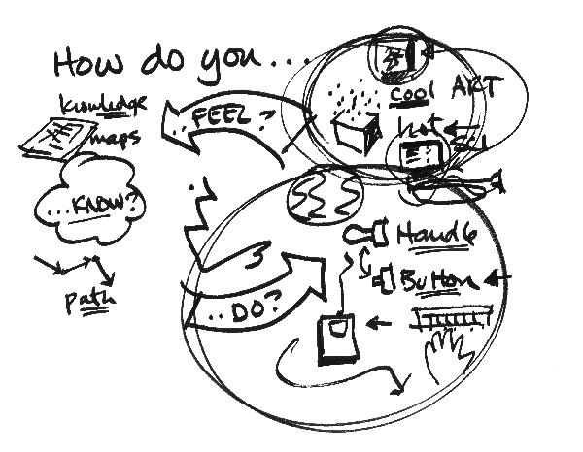
Interaction Design
Ideation Sessions
Prototyping
Charettes
Notes:
Using user research results to improve the usability and experience of the product
Concrete stuff –
Style - color, texture, design and use of widgets
Content strategy – communication back to the user – messages
Less concrete stuff –
User behavior, motivation, persona type stuff
Goal is to shape system behaviors that map to user behavior
Service design
Techniques -Ideation session, prototyping
Charette
The word charrette may refer to any collaborative session in which a group of designers drafts a solution to a design problem. While the structure of a charrette varies, depending on the design problem and the individuals in the group, charrettes often take place in multiple sessions in which the group divides into sub-groups. Each sub-group then presents its work to the full group as material for future dialogue. Such charrettes serve as a way of quickly generating a design solution while integrating the aptitudes and interests of a diverse group of people. Compare this term with workshop.
Review the problem, context, introduce users (personas)
Sketch ideas
Share ideas
Identify patterns
Determine presentation styles, flow
Dig into the content
What message do we want the user to get – web page
Affinity between pages
Good resource. About Face by Alan Cooper.
Low: 3min
High: 6min

Slide 6

Usability
Usability Testing
Behavior Driven Design
Notes:
Testing with an audience in their context. Take the application to them instead of using a lab
Have them talk out loud as they interact with the system
Look for clues of frustration, complexity, delight
Respond with design changes
BDD
Using the Given, When, Then format for acceptance criteria.
We already talked about this.
Low: 1min
High: 3min

Slide 7
Analysis and Distributed Teams

Slide 8
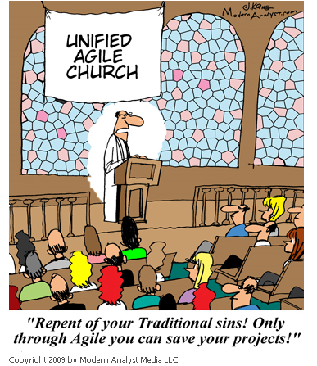
Notes:
Distributed projects are difficult in any environment, but especially difficult with Agile projects.
Agile projects are based on communication, feedback, quick turnaround.
The farther away geographically, the more difficult.
1min

Slide 9



Counterpart or no?
Notes:
Do you have a counterpart in the other location?
If yes, how will you split the work?
Do not split by functional area. Be a part of the entire system. You don’t want to get to the point where only you know something.
Switch off who drives the showcases
Use visual aids for everything. Models help describe details
Do regular feature walk throughs with the team and/or just counterpart
Narratives have to be more detailed
Low: 2min
High: 3min

Slide 10

Counterpart or no?
Notes:
Do you have a counterpart in the other location?
If not, that is going to be very tough supporting distributed developers.
Find someone at the other location to be your support.
Collect questions from devs/QA, etc
Schedule a morning and evening session if time zone challenged
If not, keep IM open
Low: 1min
High: 3min

Slide 11

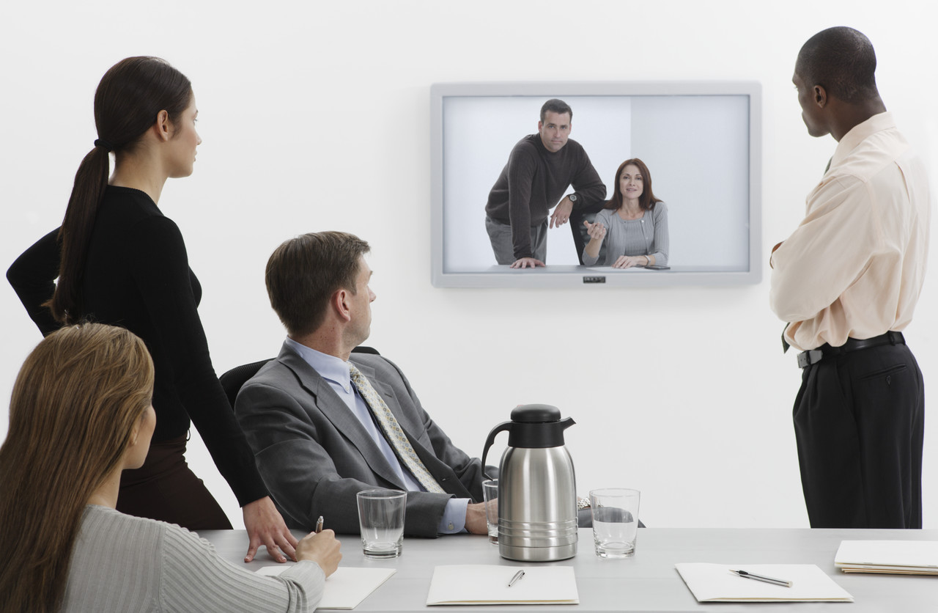
Effectiveness of the medium
Notes:
Telephone
Skype
Video conference
Better yet, conduct regular visits.
Use IM to support distributed in both locations – ‘can you repeat that’ or ‘I didn’t catch that’
State when a topic is starting and finishing
Screen share if possible
Post questions on a wiki or other central spot for preparation, research
Avoid abbreviations and partial sentences.
Low: 1min
High: 2min

Slide 12
Scheduling
Notes:
2 standups to accommodate both schedules day start
Overlapping hours outside of the standups. To clarify, review, question, etc.
Share the pain – alternate meeting schedules, i.e. late night here vs. late night there
Low: 1min
High: 2min

Slide 13
Rubber Hits Road: Do Try This At Home!

Slide 14
Your turn to share
Share one new practice you will begin using andhow this will help your analysis work, eliminate or reduce a challenge, etc.
Notes:
Low: 5min
High: 15min

Slide 15
Retrospective and Evaluations

Slide 16
Thank you!
www.ThoughtWorks-Studios.com

